Slide 1
Week 2
Update
Nick Darby

Slide 2
Progress
Mergred Chloe’s Work
Implemented Labelling System

Slide 3

Challenges
Mismatching PP & .vdb Files

Slide 4
Next Steps
Perfect Labelling System
Complete Admin Page
Add Blind Review
Create ML Classifier

Slide 5
Week 3
Quick
Update
Nick Darby

Slide 6
Progress
Planned out finished Admin page
Prepared and presented at Clarkfest

Slide 7
Challenges
Forgot a life size picture of cyanobacteria on poster

Slide 8
Next Steps
Complete Admin Page
Add Blind Review
Labelling should be a textbox that brings options above as it gets typed out
Meet w/Prof. Ahlgren

Slide 9
Week 4 Update
Nick Darby
Weekly Update
Progress
Challenges
Future Plans

Slide 10
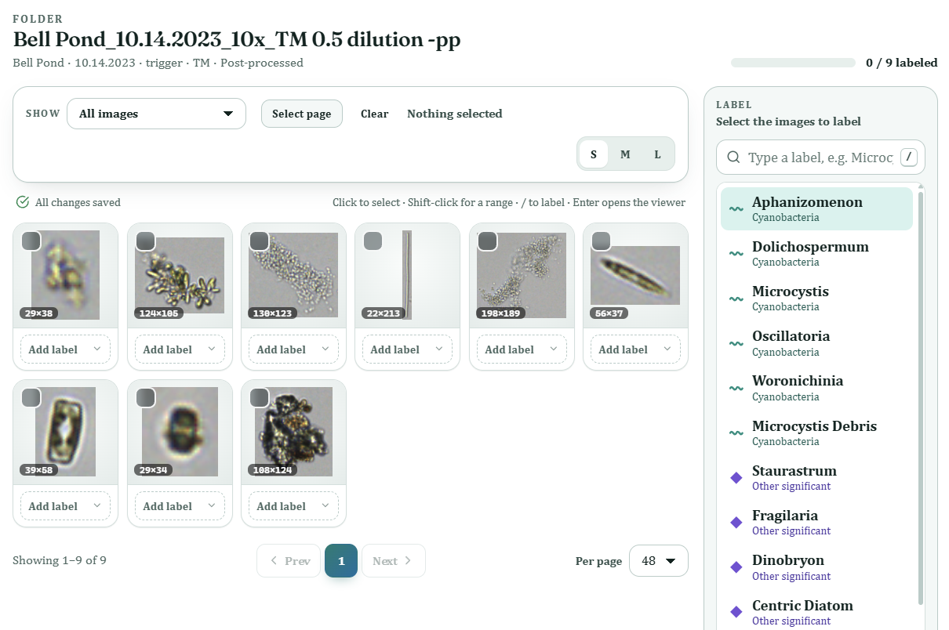
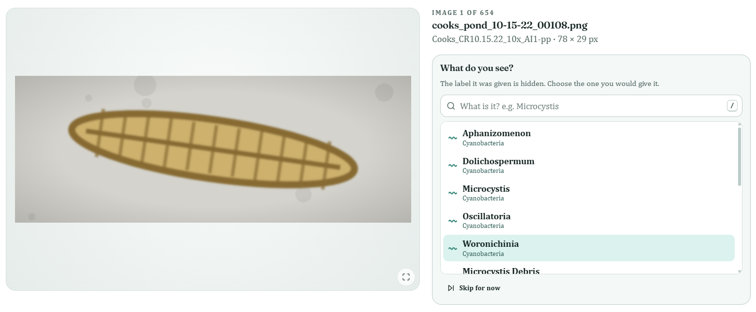
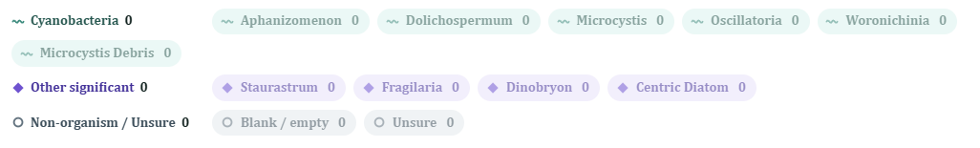
Progress
Weekly Update
Progress
Challenges
Future Plan
Overhauled Labelling UI
Corrected Labelling Categories + Ahlgren
Created Blind Review Demo

Slide 11
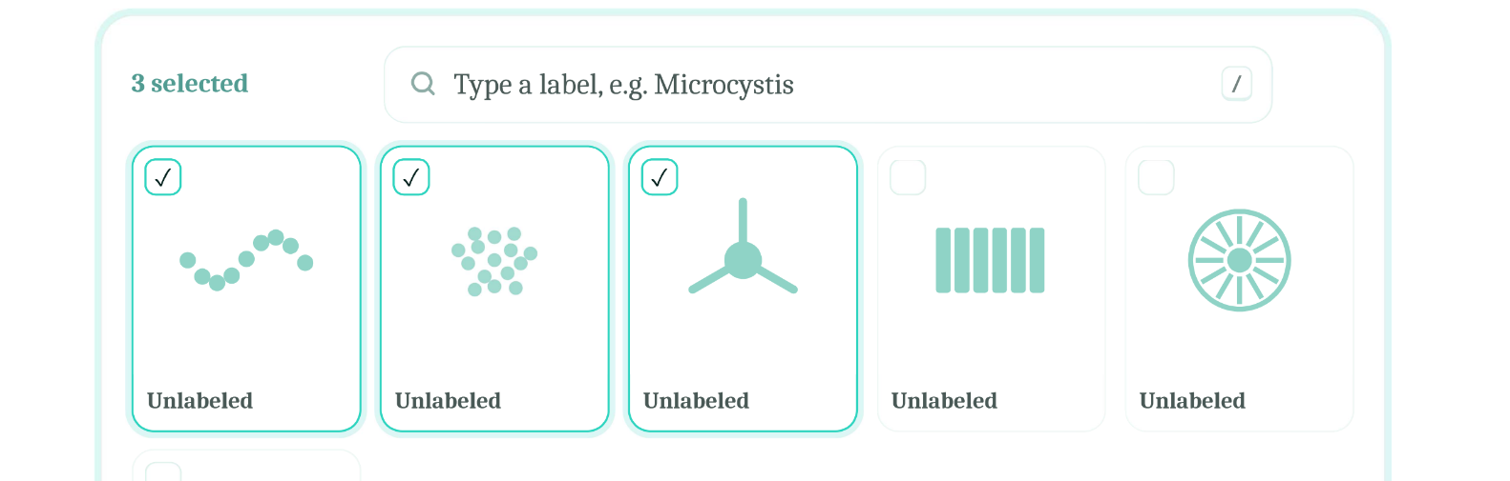
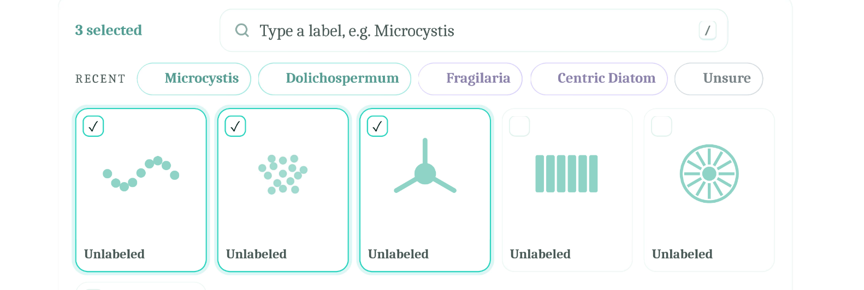


Challenges
Weekly Update
Progress
Challenges
Future Plan
Deciding New Labelling System Look
Computer Crashed During Git Commits

Slide 12
Future Plans
Weekly Update
Progress
Challenges
Future
Finish Blind Review
Meet with Chloe
Small Fixes

